Slide 1
Chapter 8: Main Memory

Slide 2
Chapter 8: Memory Management
Background
Swapping
Contiguous Memory Allocation
Segmentation
Paging
Structure of the Page Table
Example: The Intel 32 and 64-bit Architectures
Example: ARM Architecture

Slide 3
Objectives
To provide a detailed description of various ways of organizing memory hardware
To discuss various memory-management techniques, including paging and segmentation
To provide a detailed description of the Intel Pentium, which supports both pure segmentation and segmentation with paging

Slide 4
Background
Program must be brought (from disk) into memory and placed within a process for it to be run
Main memory and registers are only storage CPU can access directly
Memory unit only sees a stream of addresses + read requests, or address + data and write requests
Register access in one CPU clock (or less)
Main memory can take many cycles, causing a stall (processor does not have the data required to complete the instruction that it is executing).
Cache sits between main memory and CPU registers
Protection of memory required to ensure correct operation
Notes:
Most CPUs can decode instructions and perform simple operations on register contents at the rate of one or more operations per clock tick.
The same cannot be said of main memory, which is accessed via a transaction on the memory bus. Completing a memory access may take
many cycles of the CPU clock. In such cases, the processor normally needs to stall, since it does not have the data required to complete the instruction that it
is executing. This situation is intolerable because of the frequency of memory
accesses. The remedy is to add fast memory between the CPU and main memory,
typically on the CPU chip for fast access. Such a cache was described in Section
1.8.3. To manage a cache built into the CPU, the hardware automatically speeds
up memory access without any operating-system control

Slide 5
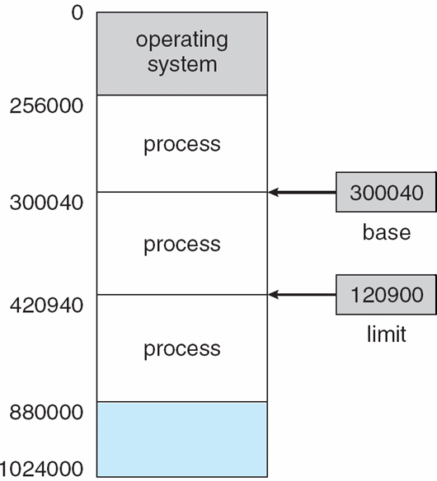
Base and Limit Registers
Protection of memory space is accomplished by having the CPU hardware compare every address generated in user mode with the registers.
A pair of base and limit registers define the logical address space
CPU must check every memory access generated in user mode to be sure it is between base and limit for that user
Notes:
Protection of memory space is accomplished by having the CPU hardware
compare every address generated in user mode with the registers. Any attempt
by a program executing in user mode to access operating-system memory or
other users’ memory results in a trap to the operating system, which treats the
attempt as a fatal error (Figure 8.2).

Slide 6
Hardware Address Protection

Slide 7
Address Binding
Programs on disk, ready to be brought into memory to execute form an input queue
Without support, must be loaded into address 0000
Inconvenient to have first user process physical address always at 0000
Further, addresses represented in different ways at different stages of a program’s life
Source code addresses usually symbolic
Compiled code addresses bind to relocatable addresses
i.e. “14 bytes from beginning of this module”
Linker or loader will bind relocatable addresses to absolute addresses
i.e. 74014
Each binding maps one address space to another
Notes:
Addresses may be represented in different ways during these steps. Addresses in the source
program are generally symbolic (such as the variable count). A compiler
typically binds these symbolic addresses to relocatable addresses (such as
“14 bytes from the beginning of this module”). The linkage editor or loader
in turn binds the relocatable addresses to absolute addresses (such as 74014).
Each binding is a mapping from one address space to another.
Classically, the binding of instructions and data to memory addresses can
be done at any step along the way:

Slide 8
Binding of Instructions and Data to Memory
Address binding of instructions and data to memory addresses can happen at three different stages
Compile time: If memory location known a priori, absolute code can be generated; must recompile code if starting location changes
Load time: Must generate relocatable code if memory location is not known at compile time
If the starting address changes, we need only reload the user code
Execution time: Binding delayed until run time if the process can be moved during its execution from one memory segment to another
Need hardware support for address maps (e.g., base and limit registers)
Notes:
Compile time. If you know at compile time where the process will reside in memory, then absolute code can be generated. For example, if you know
that a user process will reside starting at location R, then the generated compiler code will start at that location and extend up from there. If, at
some later time, the starting location changes, then it will be necessary to recompile this code.
Load time. If it is not known at compile time where the process will reside in memory, then the compiler must generate relocatable code. In this case,
final binding is delayed until load time. If the starting address changes, we need only reload the user code to incorporate this changed value.
Execution time. If the process can be moved during its execution from one memory segment to another, then binding must be delayed until run
time. Special hardware must be available for this scheme to work, as will be discussed in Section 8.1.3. Most general-purpose operating systems use
this method.

Slide 9
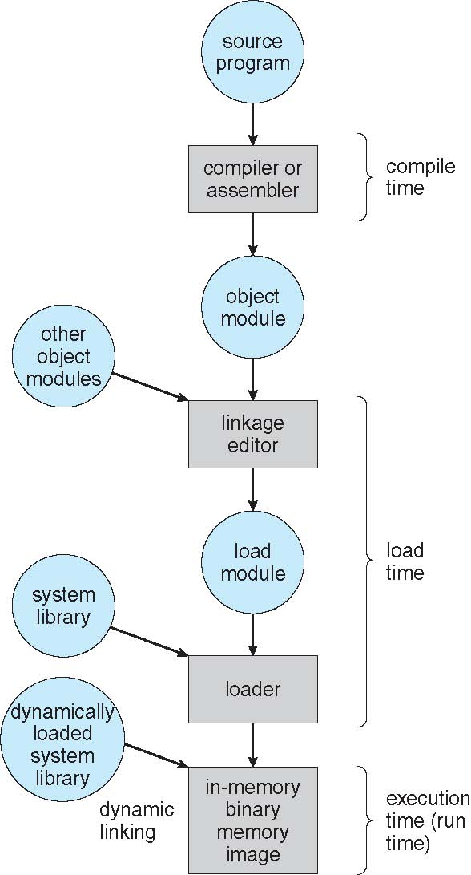
Multistep Processing of a User Program

Slide 10
Logical vs. Physical Address Space
The concept of a logical address space that is bound to a separate physical address space is central to proper memory management
Logical address – generated by the CPU; also referred to as virtual address
Physical address – address seen by the memory unit
Logical and physical addresses are the same in compile-time and load-time address-binding schemes; logical (virtual) and physical addresses differ in execution-time address-binding scheme
Logical address space is the set of all logical addresses generated by a program
Physical address space is the set of all physical addresses corresponding to these logical addresses

Slide 11
Memory-Management Unit (MMU)
Hardware device called the memory-management unit (MMU) that maps virtual address to physical address at run time
Many methods possible, covered in the rest of this chapter
To start, consider simple scheme where the value in the relocation register is added to every address generated by a user process at the time it is sent to memory
Base register now called relocation register
The user program deals with logical addresses; it never sees the real physical addresses
Execution-time binding occurs when reference is made to location in memory
Logical address bound to physical addresses

Slide 12
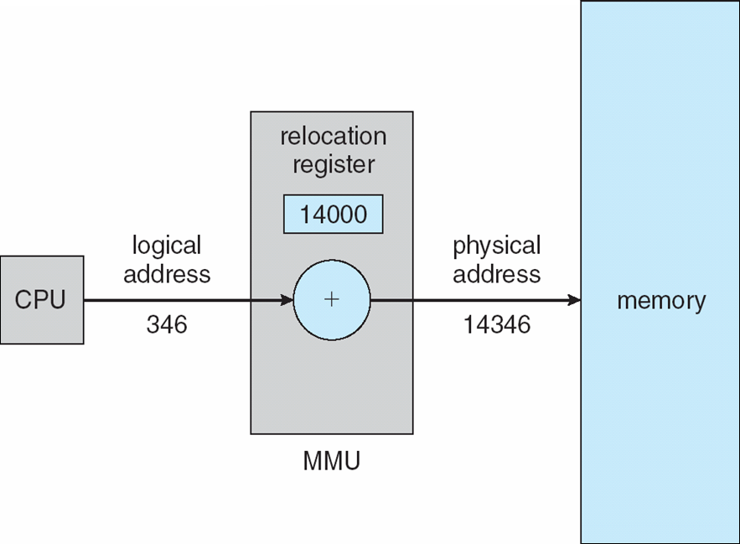
Dynamic relocation using a relocation register
Dynamic Loading Process:
Routine is not loaded until it is called
Better memory-space utilization; unused routine is never loaded
All routines kept on disk in relocatable load format
Useful when large amounts of code are needed to handle infrequently occurring cases
No special support from the operating system is required
Implemented through program design
OS can help by providing libraries to implement dynamic loading

Slide 13
Dynamic Linking
Static linking – system libraries and program code combined by the loader into the binary program image
Dynamic linking –linking postponed until execution time
Small piece of code, stub, used to locate the appropriate memory-resident library routine
Stub replaces itself with the address of the routine, and executes the routine
Operating system checks if routine is in processes’ memory address
If not in address space, add to address space
Notes:
Dynamic linking, in contrast, is similar to dynamic loading. Here, though, linking, is postponed until execution time.
This feature is usually used with system libraries, such as language subroutine libraries.
Without this facility, each program on a system must include a copy of its language library (or at least the routines referenced by the program) in the executable image. This requirement wastes both disk space and main memory.
With dynamic linking, a stub is included in the image for each library routine reference.
The stub is a small piece of code that indicates how to locate the appropriate memory-resident library routine or how to load the library if
the routine is not already present.
When the stub is executed, it checks to see whether the needed routine is already in memory. If it is not, the program loads
the routine into memory. Either way, the stub replaces itself with the address of the routine and executes the routine.
Thus, the next time that particular code segment is reached, the library routine is executed directly, incurring no
cost for dynamic linking. Under this scheme, all processes that use a language library execute only one copy of the library code.

Slide 14
Swapping
A process can be swapped temporarily out of memory to a backing store, and then brought back into memory for continued execution
Total physical memory space of processes can exceed physical memory
Backing store – fast disk large enough to accommodate copies of all memory images for all users; must provide direct access to these memory images
Roll out, roll in – swapping variant used for priority-based scheduling algorithms; lower-priority process is swapped out so higher-priority process can be loaded and executed
Major part of swap time is transfer time; total transfer time is directly proportional to the amount of memory swapped
System maintains a ready queue of ready-to-run processes which have memory images on disk

Slide 15
Swapping (Cont.)
If next processes to be put on CPU is not in memory, need to swap out a process and swap in target process
Context switch time can then be very high
100MB process swapping to hard disk with transfer rate of 50MB/sec
Swap out time of 2000 ms
Plus swap in of same sized process
Total context switch swapping component time of 4000ms (4 seconds)
Can reduce if reduce size of memory swapped – by knowing how much memory really being used

Slide 16
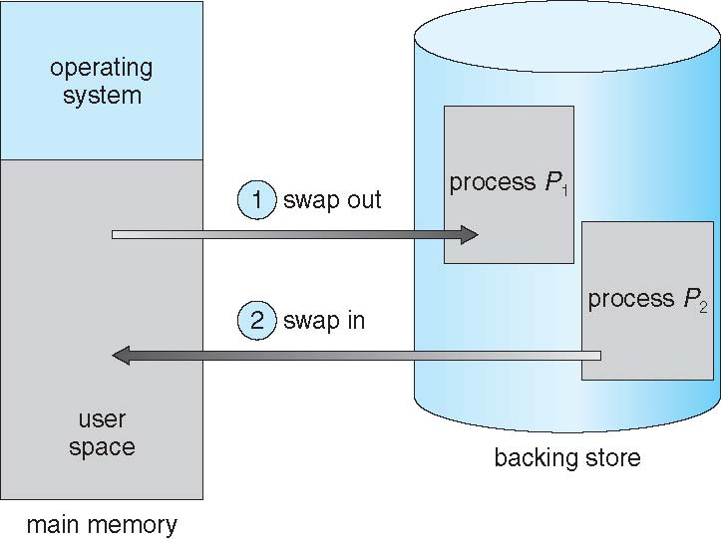
Schematic View of Swapping

Slide 17
Context Switch Time and Swapping (Cont.)
Other constraints as well on swapping
Pending I/O – can’t swap out as I/O would occur to wrong process
Or execute I/O operations only into operating-system buffers.
Transfers between operating-system buffers and process memory then occur only when the process is swapped in. this is called double buffering, and it adds overhead
Standard swapping not used in modern operating systems
Modified versions of swapping are found on many systems (i.e., UNIX, Linux, and Windows)
Swapping normally disabled
if the amount of free memory falls below a threshold amount. Swapping is halted
Memory Disabled again once memory demand reduced below threshold

Slide 18
Swapping on Mobile Systems
Not typically supported
Flash memory based
Small amount of space
Limited number of write cycles to flash
Poor throughput between flash memory and CPU on mobile platform
Instead use other methods to free memory if low
iOS asks apps to voluntarily relinquish allocated memory
Read-only data thrown out and reloaded from flash if needed
Failure to free can result in termination
Android terminates apps if low free memory, but first writes application state to flash for fast restart

Slide 19
Contiguous Allocation
Main memory must support both OS and user processes
Limited resource, must allocate efficiently
Contiguous allocation is one early method
Main memory usually into two partitions:
Resident operating system, usually held in low memory with interrupt vector
User processes then held in high memory
Each process contained in single contiguous section of memory

Slide 20
Contiguous Allocation (Cont.)
MEMORY PROTECTION:
Relocation registers used to protect user processes from each other, and from changing operating-system code and data
Base register (relocation register) contains value of smallest physical address
Limit register contains range of logical addresses – each logical address must be less than the limit register
MMU maps logical address dynamically

Slide 21
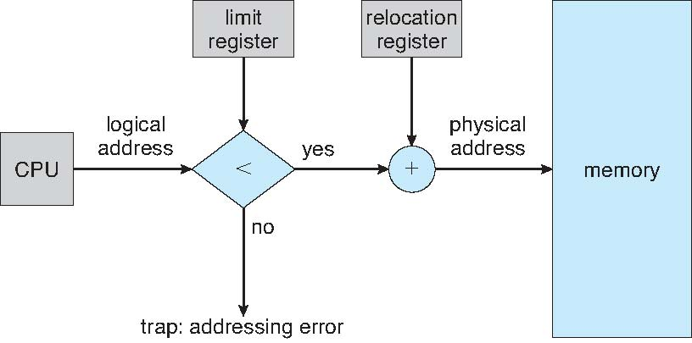
Hardware Support for Relocation and Limit Registers

Slide 22
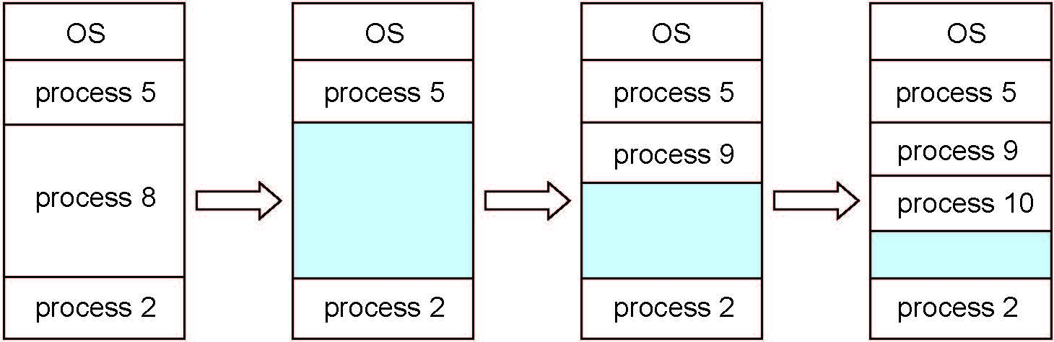
Multiple-partition allocation
Multiple-partition allocation
Degree of multiprogramming limited by number of partitions
Variable-partition sizes for efficiency (sized to a given process’ needs)
Hole – block of available memory; holes of various size are scattered throughout memory
When a process arrives, it is allocated memory from a hole large enough to accommodate it
Process exiting frees its partition, adjacent free partitions combined
Operating system maintains information about: a) allocated partitions b) free partitions (hole)

Slide 23
Dynamic Storage-Allocation Problem
How to satisfy a request of size n from a list of free holes?
First-fit: Allocate the first hole that is big enough
Best-fit: Allocate the smallest hole that is big enough; must search entire list, unless ordered by size
Produces the smallest leftover hole
Worst-fit: Allocate the largest hole; must also search entire list
Produces the largest leftover hole
First-fit and best-fit better than worst-fit in terms of speed and storage utilization

Slide 24
Fragmentation
External Fragmentation – total memory space exists to satisfy a request, but it is not contiguous
Internal Fragmentation – allocated memory may be slightly larger than requested memory; this size difference is memory internal to a partition, but not being used
First fit statistical analysis reveals that given N blocks allocated, another 0.5 N blocks lost to fragmentation
1/3 may be unusable -> 50-percent rule

Slide 25
Fragmentation (Cont.)
Reduce external fragmentation by compaction
Shuffle memory contents to place all free memory together in one large block
Compaction is possible only if relocation is dynamic, and is done at execution time
I/O problem
Latch job in memory while it is involved in I/O
Do I/O only into OS buffers

Slide 26
Fragmentation (Cont.)
A possible solution to the external-fragmentation problem is to permit the logical address space of the processes to be noncontiguous.
Allow a process to be allocated physical memory wherever such memory is
available.
Two techniques achieve this solution:
Segmentation
Paging

Slide 27
Activity
Given five memory partitions of 100 KB, 500 KB, 200 KB, 300 KB, and 600 KB (in order), how would each of the first-fit, best-fit, and worst-fit algorithms place processes of 212 KB, 417 KB, 112 KB, and 426 KB (in order)? Which algorithm makes the most efficient use of memory?

Slide 28
Activity Answer
First-fit:
212K is put in 500K partition
417K is put in 600K partition
112K is put in 288K partition (new partition 288K = 500K - 212K)
426K must wait
Best-fit:
212K is put in 300K partition
417K is put in 500K partition
112K is put in 200K partition
426K is put in 600K partition

Slide 29
Activity Answer
Worst-fit:
212K is put in 600K partition
417K is put in 500K partition
112K is put in 388K partition
426K must wait
In this example, Best-fit turns out to be the best.

